Slide 1
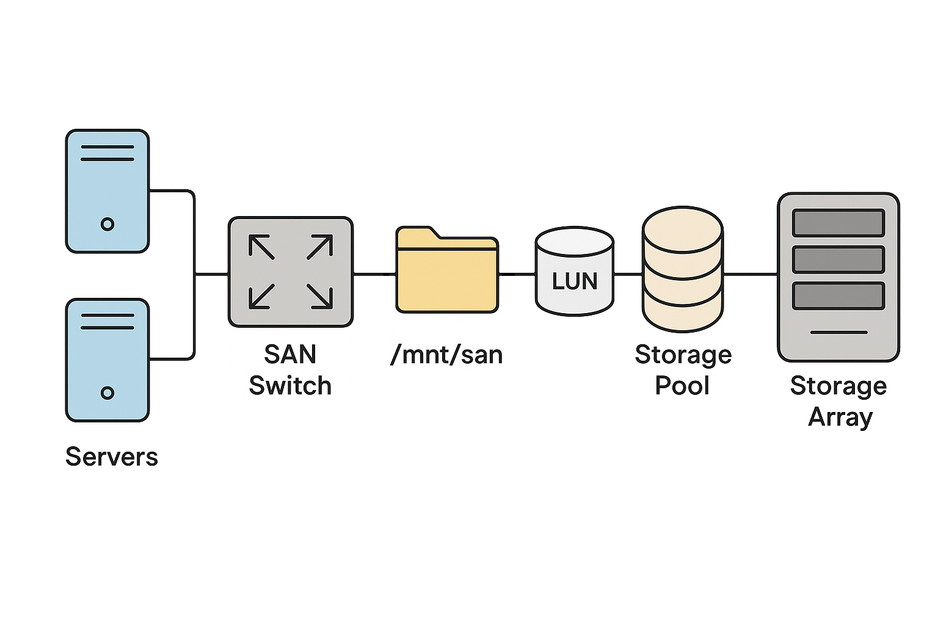

Slide 2
RAID Level | Min Disks | Fault Tolerance | Description
RAID 0 | 2 | ❌ None | Striping only. High performance, but if one disk fails, all data is lost.
RAID 1 | 2 | ✅ 1 disk | Mirroring. Exact copy on each disk. High redundancy but halves usable storage.
RAID 5 | 3 | ✅ 1 disk | Striping with parity. Good performance and redundancy. Data + parity spread across disks.
RAID 6 | 4 | ✅ 2 disks | Like RAID 5 but with double parity. Can survive 2 disk failures.
RAID 10 (1+0) | 4 | ✅ Up to 2 (depends on which fail) | Mirrored pairs + striped. High performance and fault tolerance.
RAID 50 | 6+ | ✅ Up to 2+ | Stripe across multiple RAID 5 sets. Balance of speed and fault tolerance.
RAID 60 | 8+ | ✅ Up to 4+ | Stripe across multiple RAID 6 sets. High fault tolerance and performance.

Slide 3
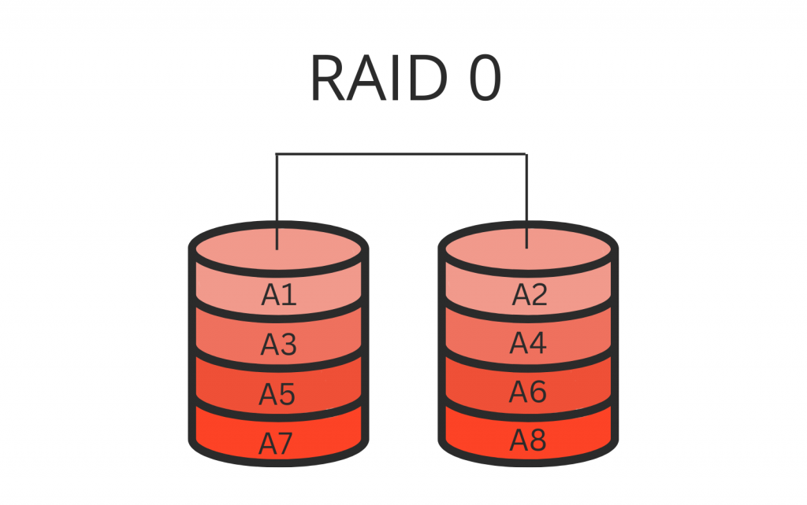

Slide 4
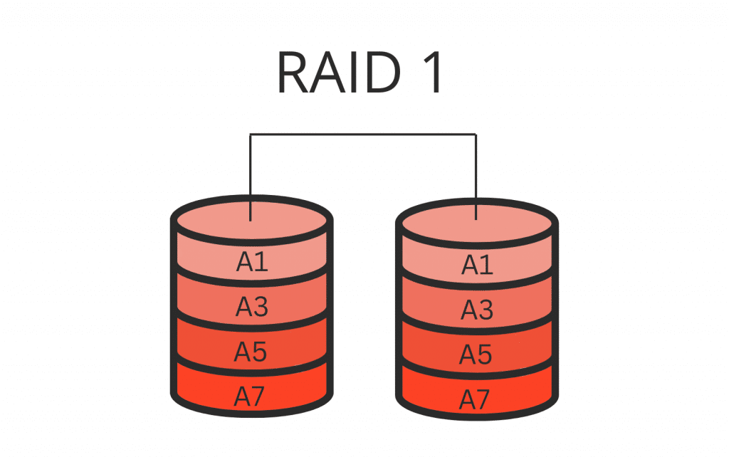

Slide 5
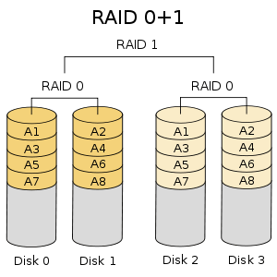

Slide 6
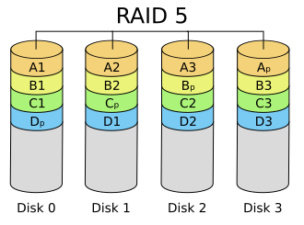

Slide 7
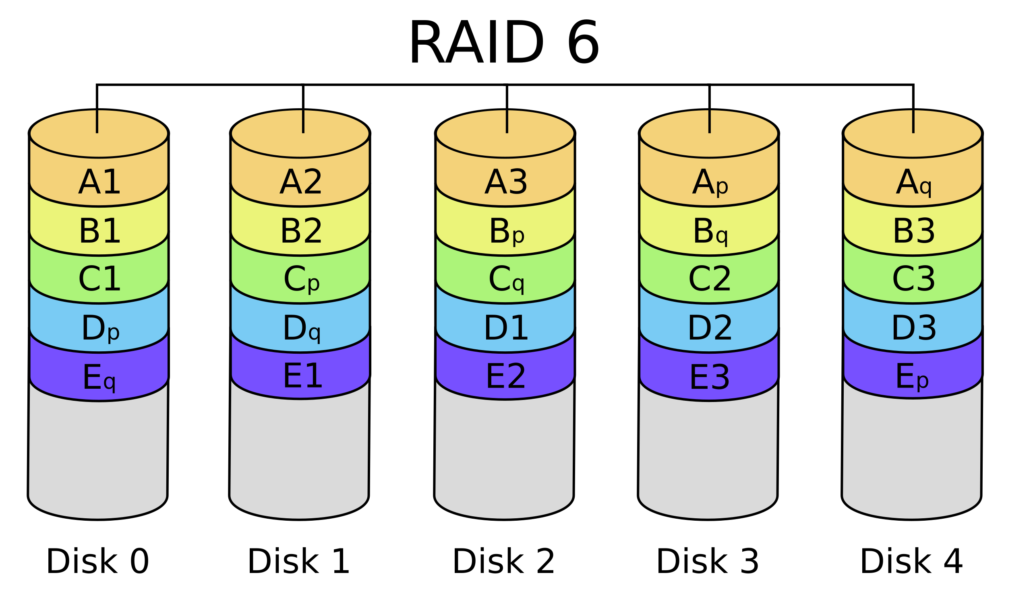

Slide 8
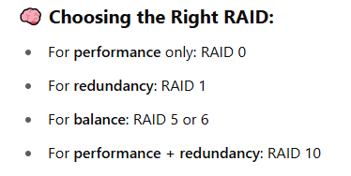

Slide 9
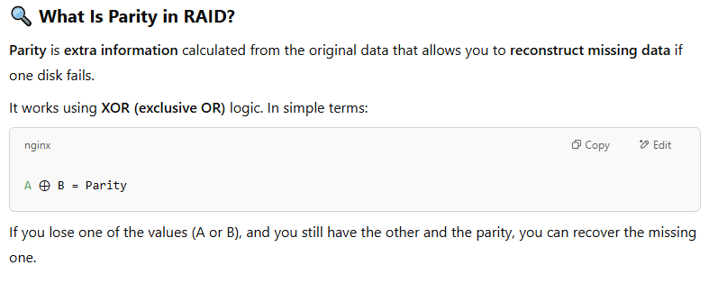

Slide 10
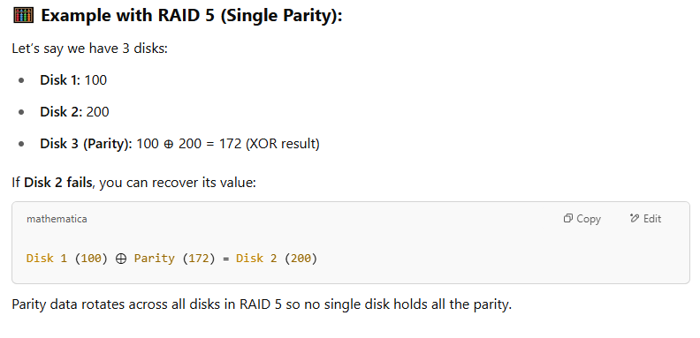

Slide 11
